Slide 1
Temporal Graph Networks lecture-10 Course on Graph Neural Networks (Winter Term 20/21)
Christian Medeiros Adriano (christian.adriano@hpi.de) - “Chris”
Max Schumacher (schumacher2@uni-potsdam.de)
Sona Ghahremani (sona.ghahremani@hpi.de )
Prof. Dr. Holger Giese (holger.giese@hpi.de)

Slide 2
Time in Networks
Nodes and edges of certain networks change over time
Twitter
News Comments
Traffic
Graphical Examples

Slide 3
Quick recap – Where are we now?
Graph Metrics and Random Models
Graph Classification - Clustering
Graph Sampling - Random Walks
Graph Embeddings - Message Passing
PageRank
Graph Structure Learning
Graph Convolutional Networks
Graph Attention Networks
Graph Evolution Networks
Temporal Graph Networks
Graph Generative Models
Network Effects, Cascading and Contagion
Outbreak Detection in Networks
Influence Maximization in Networks
Design concerns
Understand a phenomenon
Extract features
Stablish baselines
Preprocessing data
Description models
Predict an outcome
ML architecture and pipeline
Training models
Evaluation models
Prediction models
Effects of interventions
Risks of confounding
Causal structure
Intervention models
Notes:
[Wang & Tax 2016] Wang, Feng, and David MJ Tax. "Survey on the attention based RNN model and its applications in computer vision." arXiv preprint arXiv:1601.06823 (2016).
[Luong et al. 2015] Luong, Minh-Thang, Hieu Pham, and Christopher D. Manning. "Effective approaches to attention-based neural machine translation." arXiv preprint arXiv:1508.04025 (2015).
[Vaswani et al. 2017] Vaswani, A., Shazeer, N., Parmar, N., Uszkoreit, J., Jones, L., Gomez, A. N., ... & Polosukhin, I. (2017). Attention is all you need. Advances in neural information processing systems, 30, 5998-6008.
Bahdanau, Dzmitry, Kyunghyun Cho, and Yoshua Bengio. "Neural machine translation by jointly learning to align and translate." arXiv preprint arXiv:1409.0473 (2014).
Xu, Kelvin, et al. "Show, attend and tell: Neural image caption generation with visual attention." International conference on machine learning. 2015.
The research described in the paper Graph Convolutional Network (GCN), indicates that combining local graph structure and node-level features produces good performance on node classification tasks. However, the way GCN aggregates is structure-dependent, which can hurt its generalizability.
One workaround is to simply average over all neighbor node features as described in the research paper GraphSAGE. However, Graph Attention Network proposes a different type of aggregation. GAN uses weighting neighbor features with feature dependent and structure-free normalization, in the style of attention.

Slide 4
Why do we need Temporal Graph Networks?
Time is a feature of nodes, edges, and graphs
Frequent versus stale relationships
Similarity or clustering w.r.t. time
Time itself is a characteristic to be predicted
Probability of new links in time
Network events (contagion, influence) in time

Slide 5
Brief (incomplete) historical perspective -1
2000’s – Measuring network evolution phenomena
Growth dynamics of the world-wide web [Huberman & Adamic 1999]
Graphs over time densification laws, shrinking diameters and possible explanations [Leskovec et al. 2005]
The dynamics of viral marketing [Leskovec, Adamic & Huberman 2007]
2010’s – Generative models for network evolution
Kronecker graphs an approach to modeling networks [Leskovec et al. 2010]
Emerging topic detection on twitter based on temporal and social terms evaluation [Cataldi et al. 2010]
Collaboration over time characterizing and modeling network evolution [Huang et al. 2012]

Slide 6
Brief (incomplete) historical perspective -2
2020’s – Prediction models of network evolution
Spectral Networks and Deep Locally Connected Networks on Graphs [Bruna et al. 2013]
Temporal Graph Neural Networks [Rossi et al. 2020]
Evolvegraph: Multi-agent trajectory prediction with dynamic relational reasoning [Li et al. 2020]
Spectral Temporal Graph Neural Network for Multivariate Time-series Forecasting [Cao et al. 2020]

Slide 7
Index
Motivation contrast: Continuous Time - Temporal Graph Neural Network (Chris)
Space and Time (Max)
Spacio-Temporal Convolution
Diffusion Convolution Recurrent Networks (GRU cell idea)
Recurrent Neural Networks
Graph Convolution Networks with Kalman Filtering for Traffic Prediction
Multi-Head Attention (some example)
Spectral Convolution (Chris)
Spectral Networks (short intro)
Spectral Temporal Graph Neural Network
Innovative Architectures:
EvolveGraph – Latent Graph Model (Chris)
ST-UNet: A Spatio-Temporal U-Network for Graph-structured Time Series Modeling (Max)

Slide 8
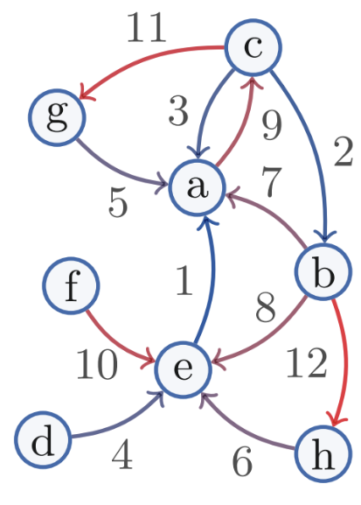
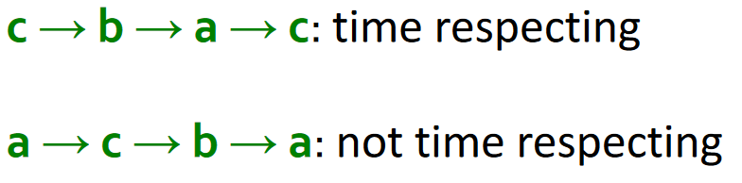
Temporal Page Rank
Goal: Make a random walk only on temporal or time-respecting paths
Intuition: Run a regular PageRank on a time-augmented graph
Time stamps increase along the path
Edge timestamps
https://web.stanford.edu/class/cs224w/slides/16-evolution.pdf

Slide 9
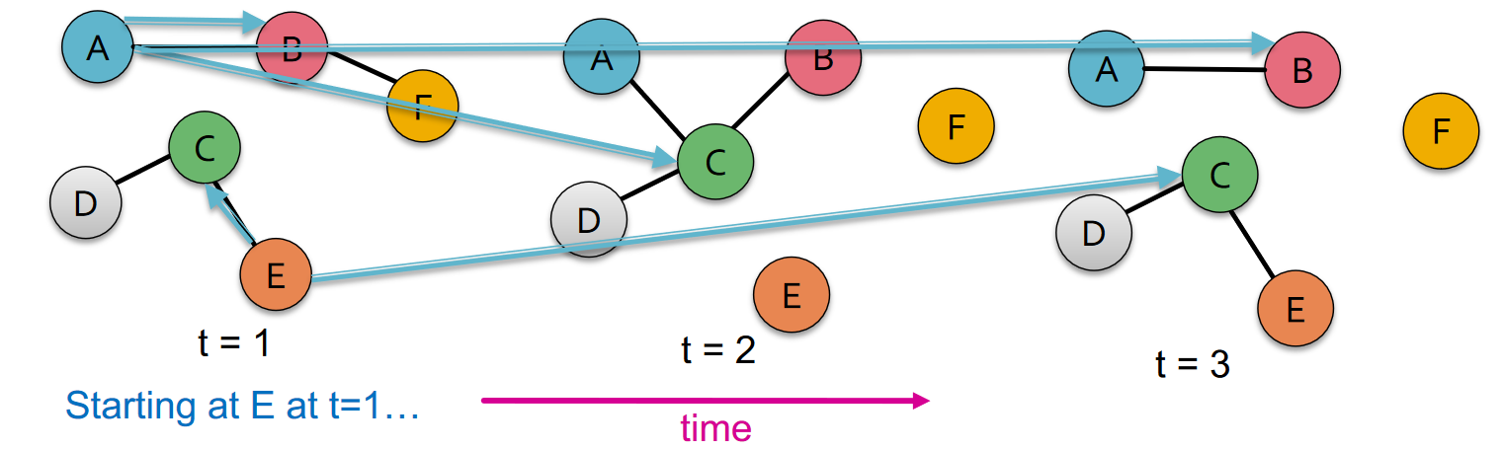
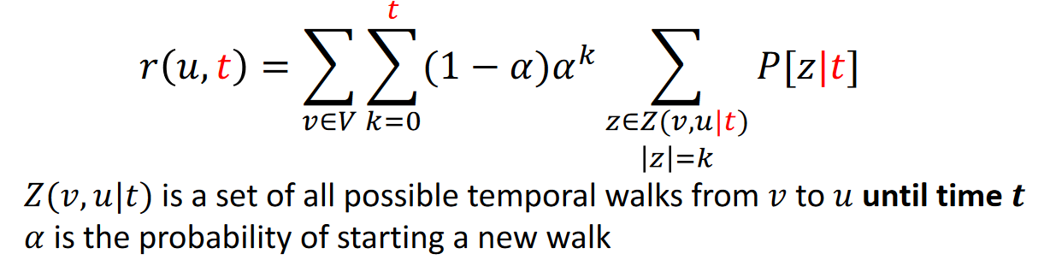
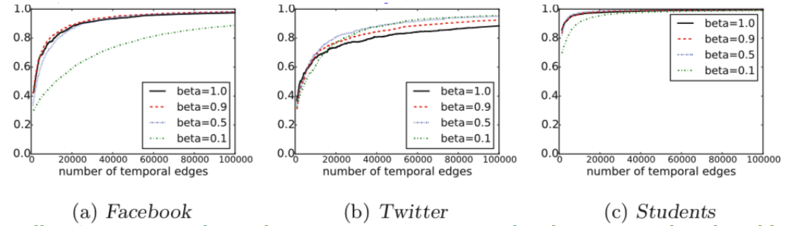
Temporal PageRank – Augmented Graph
Rank quality (Pearson corr. coeff. Between static and temporal PageRank) and transition probability 𝜷
𝑟(𝑢): Temporal PageRank estimate of 𝑢
Smaller 𝜷 corresponds to slower convergence rate, but better correlated rankings
9
https://web.stanford.edu/class/cs224w/slides/16-evolution.pdf
Notes:
Rank quality (Pearson corr. coeff. Between static and temporal PageRank) and transition probability 𝜷
Smaller 𝜷corresponds to slower convergence rate, but better correlated rankings

Slide 10

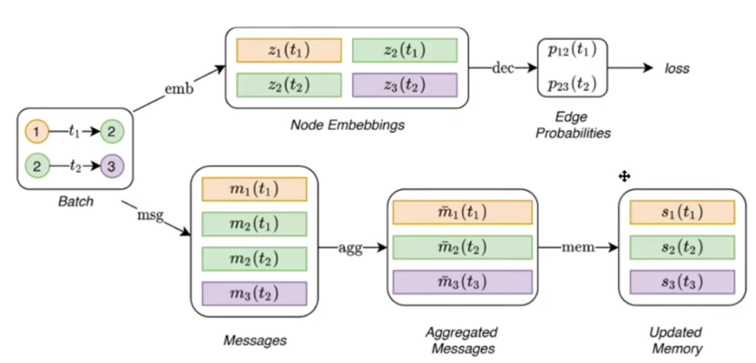
Temporal Graph Neural Networks [Rossi et al. 2020]
Goal: predict next node link in a Twitter network
Intuition: Temporal Graph Network (TGN) encoder applied on a continuous-time dynamic graph
Two types of time-stamped-event x(t):
Node-wise event is represented by node vi(t)
Interaction event e_{ij}(t) between nodes i and j
Neural Dynamic Graph [Kazemi et al.,2020]
encoder maps from a dynamic graph to node embeddings
decoder takes as input one or more node embeddings and makes a task-specific prediction, e.g. node classification or edge prediction.
temporal embedding zi(t)
Core Modules
recurrent neural network (LSTM or RNN)
Rossi et al. (2020) Temporal Graph Neural Networks, NeurIPs.
Notes:
[Kamezi et al. 2020] Seyed Mehran Kazemi, Rishab Goel, Kshitij Jain, Ivan Kobyzev, Akshay Sethi, Peter Forsyth, and
Pascal Poupart. Representation learning for dynamic graphs: A survey. Journal of Machine Learning Research, 21(70):1–73, 2020. URL http://jmlr.org/papers/v21/19-447.html

Slide 11
Spatio-Temporal Graph Networks

Slide 12
Graph Spectral Networks

Slide 13
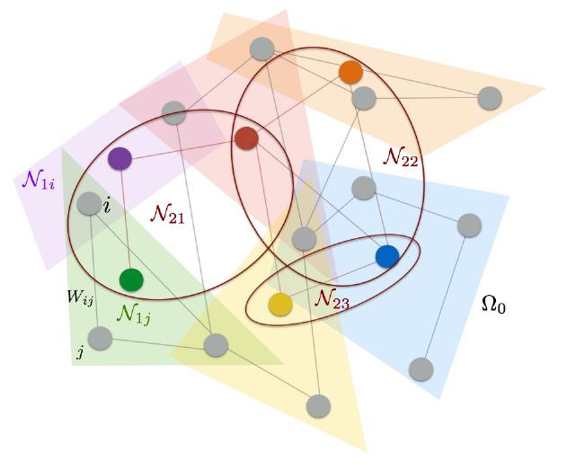
Spectral Networks
Goal: How to efficiently enable convolution over multi-dimensional spaces
Intuition: Obtain an architecture that enables a construction where the number of parameters is independent of the input dimension.
1- Spatial Construction
- Locality
- Multi-Resolution
2- Spectral Construction
Graph Laplacian, an operator (harmonic analysis on the graphs)
Extending Convolutions via the Laplacian Spectrum
Spectral Networks and Deep Locally Connected Networks on Graphs [Bruna et al. 2013]
Notes:
Spectral Networks and Deep Locally Connected Networks on Graphs [Bruna et al. 2013]

Slide 14
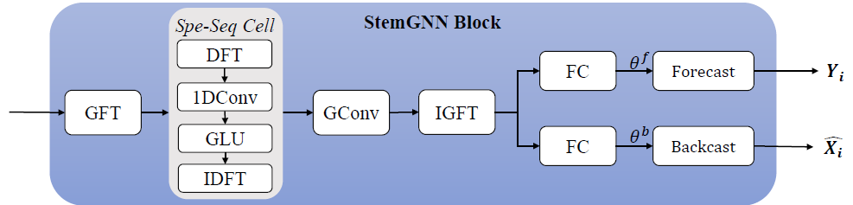
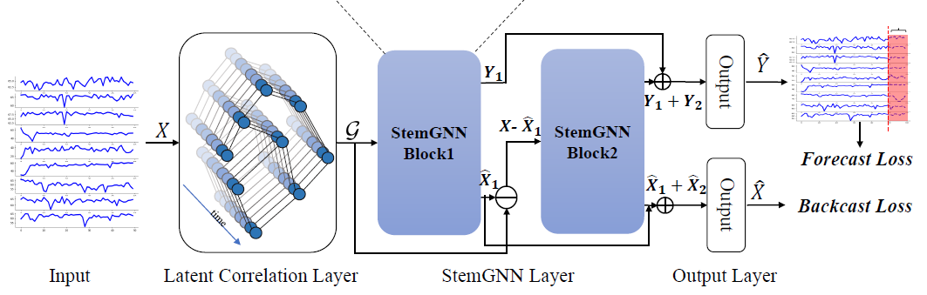

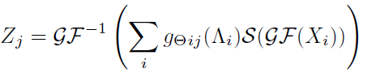


Spectral Temporal Graph Neural Network for Multivariate Time-series Forecasting
Goal: model the intra-series temporal patterns and inter-series correlations jointly
Time Series Fundamentals (Garch and Granger Causality models?)
Graph Fourier Transform (GFT)
Discrete Fourier Transform (DFT)
Latent Correlation Layer
Loss Function
Notes:
Spectral Temporal Graph Neural Network for
Multivariate Time-series Forecasting

Slide 15
Hybrid Architectures

Slide 16
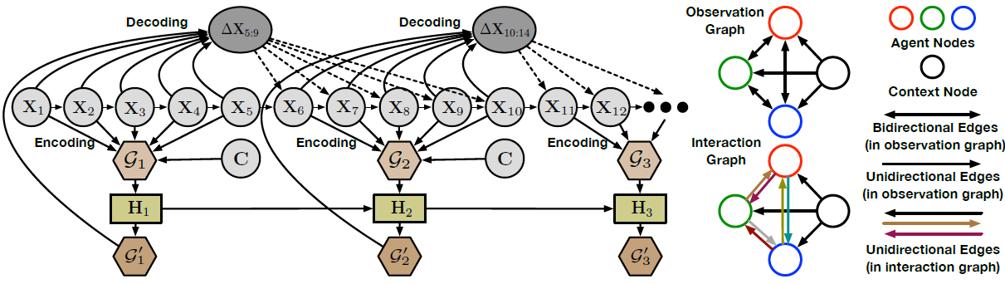
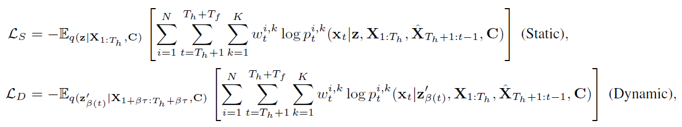
EvolveGraph: Multi-agent trajectory prediction w/ dynamic relational reasoning
Goal: Predict trajectories of multiple interacting agents
Approach: Capture and dynamically update a latent graph of agents’ interactions
Loss Functions
latent interaction graph is inferred at each time step
Li, Jiachen, et al. (2020) "Evolvegraph: Multi-agent trajectory prediction with dynamic relational reasoning," NeurIPS.
Notes:
Li, Jiachen, et al. "Evolvegraph: Multi-agent trajectory prediction with dynamic relational reasoning." Proceedings of the Neural Information Processing Systems (NeurIPS) (2020)

Slide 17
Suggested Readings on Temporal Graph Nets
[Kamezi et al. 2020] Seyed Mehran Kazemi, Rishab Goel, Kshitij Jain, Ivan Kobyzev, Akshay Sethi, Peter Forsyth, and Pascal Poupart. Representation learning for dynamic graphs: A survey. Journal of Machine Learning Research, 21(70):1–73, 2020. URL http://jmlr.org/papers/v21/19-447.html

Slide 18
Next and Future Tasks
Compute and compare graph metrics (Wednesday, 2.12)
First draft of abstract (Friday, 4.12)
Predictions using traditional method (Wednesday, 9.12)
Related work draft (Friday, 11.12)
Node and Graph Feature Learning (Wednesday, 16.12)
Any two methods of your choice
Design alternative pipelines for your GNN (Wednesday, 06.01)
Three alternative with different options for embedding, aggregation, and encoding
Test at least one.
Execute pipeline for different configurations
Sensitivity Analysis
Ablation study

Slide 19
END

